Slide 1
Medical Student
Documentation in EPIC
Michelle M. Horn, M.D.
Associate Professor, Internal Medicine and Pediatrics
Medical Student Clerkship Director, Internal Medicine
Director of Medical Education, Internal Medicine

Slide 2


Slide 3


Slide 4
Student Note
Attending Note
Legal Record

Slide 5
NOTES
Professional
Accurate
Appropriate
Pertinent

Slide 6
Note Access
History and Physicals
Progress Notes
Discharge Summaries

Slide 7
History and Physical
HPI
Past History
Review of Systems
Physical Examination
MDM and Assessment and Plan

Slide 8
CMS Changes and UMC Policy
Teaching physicians can rely on documentation, by any medical student, of the review of systems and/or past family/social history taken as part of the E/M services.
Teaching physicians can rely on the documentation or findings, including history, physical exam and/or medical decision making of a fourth year medical student so long as:
  Teaching physician personally performs (or re-performs) the physical exam and medical decision making activities of the E/M service being billed; and
  Teaching physician verifies, based on their assessment of the patient, the accuracy of the fourth year medical student's documentation of the E/M service being billed.

Slide 9

Progress Notes
Subjective
Objective
Assessment
Plan

Slide 10
Discharge Summaries
Use the Discharge Summary template
Cannot be used towards billing by the hospital

Slide 11

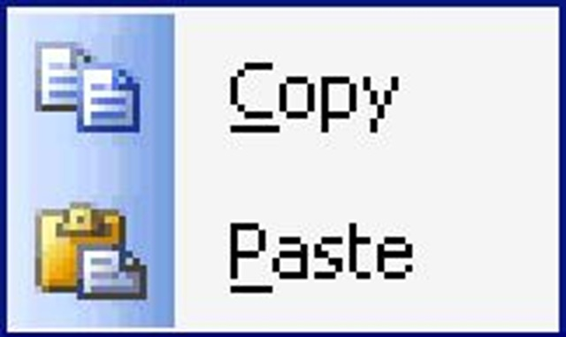

Slide 12


